Slide 1
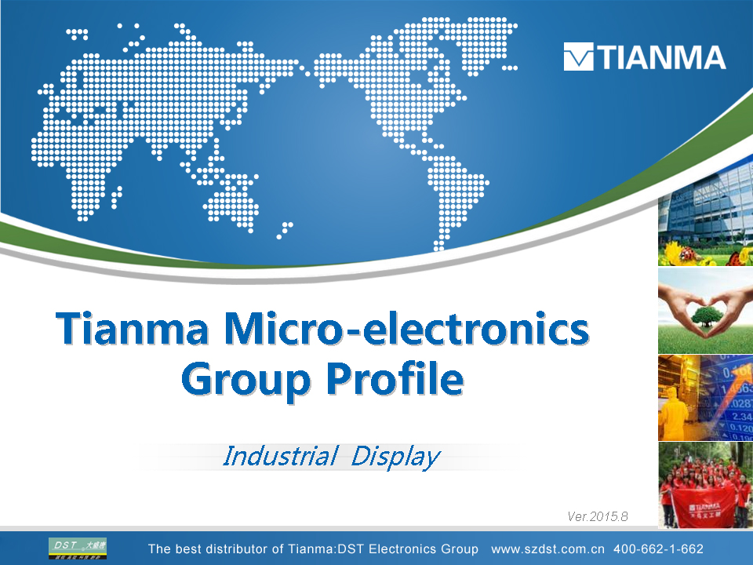




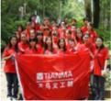
Tianma Micro-electronics
Group Profile
Industrial Display
Ver.2015.8
Notes:
Version 6.0

Slide 2
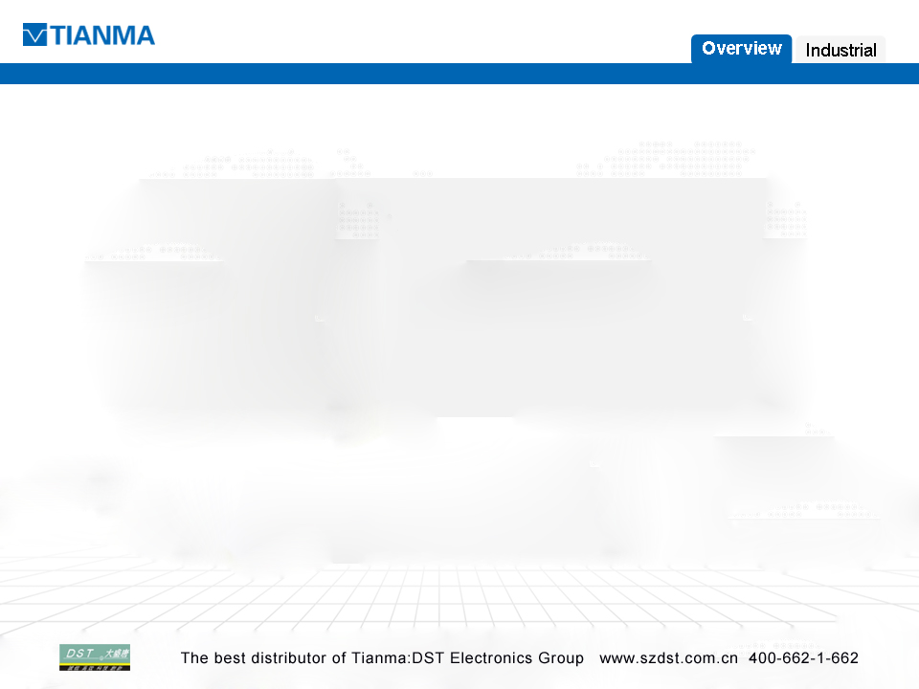

Group Overview
01
02
01

Slide 3
>>
Planning in 3~5 years
Total
Assets
Total
Employment
Revenue
$8.1 billion
Annual Sales $6.5 billion
Over 30,000
>>
Y2014
$4.0 billion
$2.2 billion
24,000

Slide 4
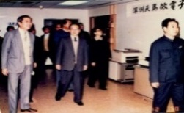
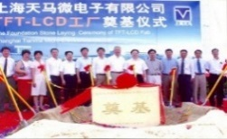
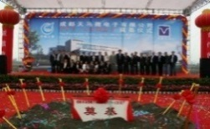
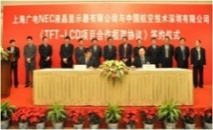
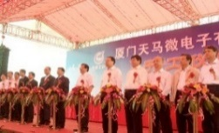
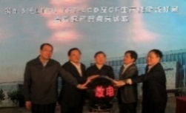
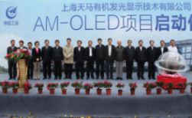
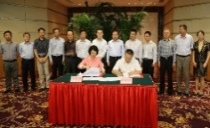
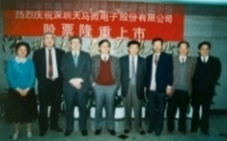
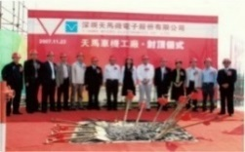
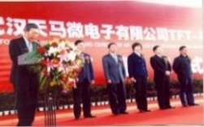
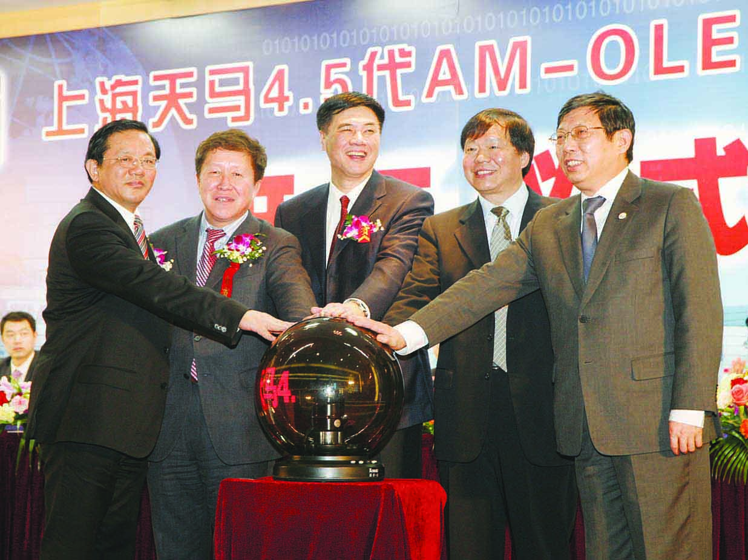
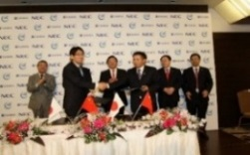
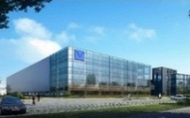
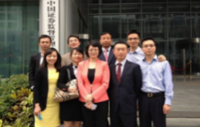
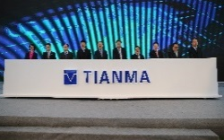
>>
Development Course
Tianma founded in Shenzhen
Shanghai Tianma founded
Chengdu Tianma established
To be the trustee of Shanghai AVIC
Xiamen Tianma project kicked off
The production line of Xiamen Tianma finished
Shanghai Tianma AM-OLED project kicked off
Xiamen G6 project signing
Nov.
1983
Mar.
1995
Apr.
2006
Jun.
2008
Sep.
2008
Nov.
2008
Jan.
2010
Aug.
2010
Dec.
2010
Jul.
2011
Dec.
2012
Apr.
2013
Oct.
2013
Sep.
2014
Sep.
2014
Mar.
2015
Tianma listed on the Shenshen Stock Exchange
The production line of Shenzhen Tianma put into operation
Wuhan Tianma established
Shanghai Tianma 4.5 amoled pilot line kicked off
To be the trustee of NLT
Shanghai Tianma OLED Technology Co., Ltd. founded
Completing asset restructuring
Wuhan G6 project kick off

Slide 5



>>
Shareholding Structure
Aviation Industry Corporation
of China
62.52%
AVIC International Holding
Total Shareholding：39.8%
Tianma Micro-electrocnics
Co.,Ltd.
AVIC International Holding
39.8%
Hubei Science & Technology Investment Group
11.72%
Other Shareholders
48.48%
as of Nov.14 2014

Slide 6
>>
Corporate Structure
TIANMA Micro-electronics Group
Professional Display BU
Consumer Display BU
Marketing & Sales Center
Operation Dept.
Operation Dept.
Marketing & Sales Center
Business Units
R&D Center
Purchasing Dept.
Purchasing Dept.
R&D Center
QA Dept.
QA Dept.
Overseas Subsidiaries
TIANMA USA
TIANMA Korea
TIANMA NLT Europe GmbH
TIANMA NLT America Inc.
Core Function System
Operation
Center
Supply
Chain Center
Advanced Technology
Development Center
Intellectual
Property Dept.
Industrial Bases
Shenzhen
TN&STN
Shanghai
G4.5
Chengdu
G4.5
Japan
G2、G3
Shanghai
G5
Wuhan
G4.5
Xiamen
G5.5
New Projects
AMOLED
LTPS-G6 Wuhan
LTPS-G6 Xiamen
BLU
Dedicated Support System

Slide 7


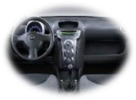

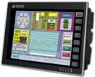



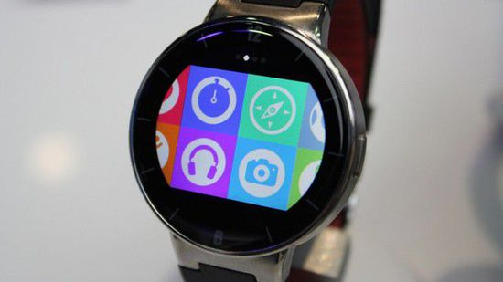
>>
Business Coverage
Professional Display
Automotive
Medical
ATM / POS
HMI
Consumer Display
Smart Phone
Tablet PC
Wearable Device

Slide 8
>>
Business Strategies
Automotive
Core business, rapid expansion strategy, get into TOP 3 by 2020
Growth
Industry Growth
Wearable
Medical
Emerging market
Focused strategy
Smart Phone
HMI
Production Line
Allocation
POS
Maturity
Core business
to be middle-high end dominance
Customer
Definition
Technical
Requirements
Tablet
PC
Niche market
Decline
Low
Middle
High
Tianma Market Share

Slide 9











>>
Production Lines Layout
Industrial Bases
 | Shenzhen | Shanghai | Chengdu | Japan NLT | Shanghai AVIC | Wuhan | Wuhan | Xiamen | Xiamen | Shanghai AM-OLED
Gen. | - | G4.5 | G4.5 | G2.5 G3 | G5 | G4.5 | G6 | G5.5 | G6 | G5.5
Tech. | TN STN | a-Si | a-Si | a-Si | a-Si | a-Si | LTPS | LTPS | LTPS | AMOLED
Established | 1983 | 2008 | 2008 | Acquired In 2011 | Acquired In 2009 | 2008 | 2014 | 2011 | 2014 | 2013
MP Since | 1984 1994 | 2008 | 2010 | 1995 | 2009 | 2011 | In building | 2013 | In building | 2015
Panel Capacities (Sheets /M) | 60K 60K | 30K | 45K | 20K 20K | 70K | 30K | 30K | 30K | 30K | 15K
Module Capacities (Pcs. /M) | 3KK | 5.8KK | - | 180K | 1KK | 2.2KK | 6KK | 6KK | 6KK | -
Japan
Shanghai
Chengdu
Xiamen
Wuhan
Shenzhen
Notes:
G2.5为LTPS线
2011年收购NLT
9

Slide 10
>>
LTPS & AMOLED Projects
Heading for high-end market
Gearing into the first FPD camp
Competing against Japan and Korea manufactures
2011
2012
2013
2014
2015
2016
Launched
Sample Released
Delivery
XiamenG5.5
LTPS
19 months
May
December
Launched
MP
New Projects
Array: 30K/M
Module: 7KK/M
Xiamen G6
LTPS
Launched
MP
Wuhan G6
LTPS
Array: 30K/M
Module: 7KK/M
Launched
Sample Released
Delivery
Shanghai G5.5
AMOLED

Slide 11
>>
Growth of net sales
Since TFT mass production, sales revenue increased over 10 times in last 7 years
In next 3~5 years, Tianma will get into the 2nd round rapid growth along with G6 LTPS been put into production

Slide 12
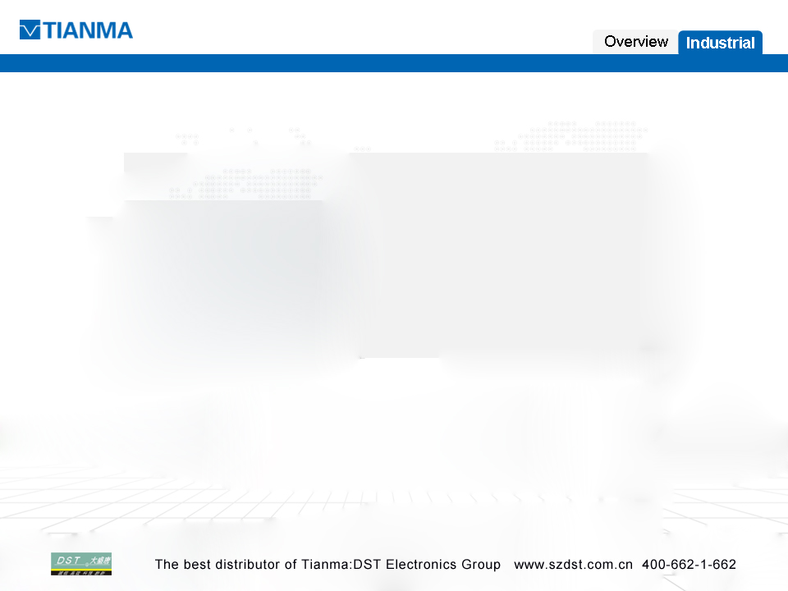

Industrial
01
02
01

Slide 13
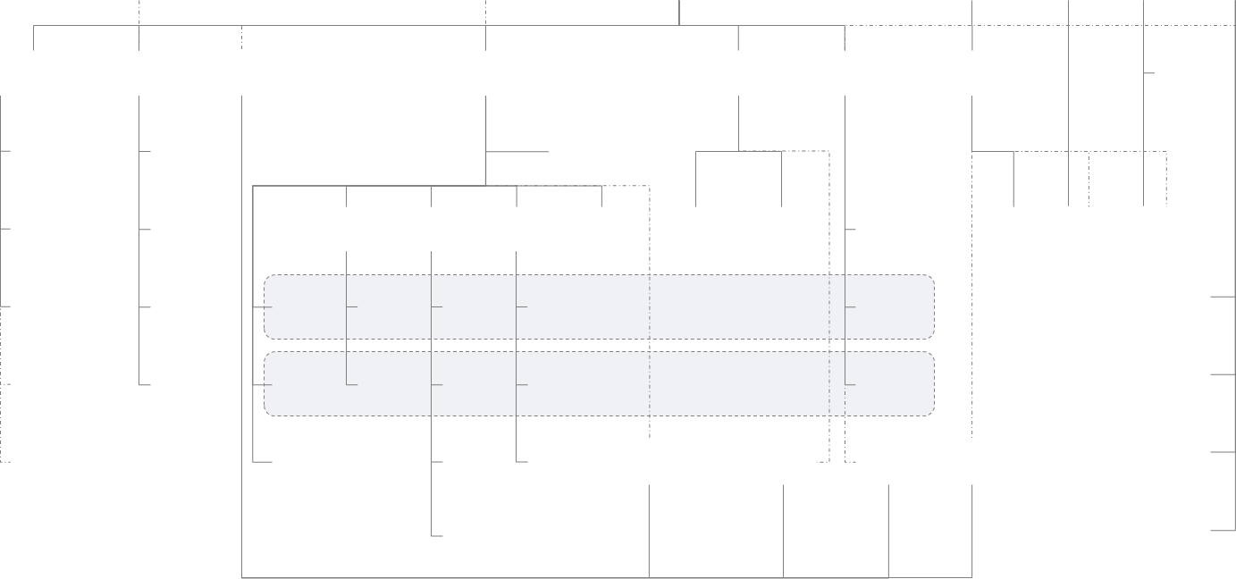
>>
Professional Display Unit Organization
Professional Display Unit
Quality
Management
Dept.
R&D
Center
Operation
Center
Business
Management
Dept.
Supply
Chain
Center
Overseas
Subsidiaries
Production
QA Dept..
NLT
Technology Center
MKT
Sales
Operation
Center
Sourcing
Shanghai
Tianma
SQ Group
Administration
Shenzhen
Tianma
DQ/
RA Group
Solution
Architecture
Dept.
Product
Design
Dept.
Platform
Technology
Dept.
Shenzhen
Technology
Dept.
Product
Plan
MKTG
Plan
Sales
Office
Planning
Dept.
Business
Management
Dept.
Purchasing
Dept.
Chengdu
Tianma
QS Group
Automotive
Project
Dept.
Automotive
Scheme
Automotive
IPT
Auto
Platform
Technology
Automotive
Product
Plan
Automotive
Sales
TNU
Shanghai AVIC
Optoelectronics
CQ Group
General
Industrial
Project
Dept.
General
Industrial
Scheme
General
Industrial
IPT
General
Industrial
Platform
Industrial
Product
Plan
Industrial
Sales
Tianma Korea
NLT
Up
Industrial
Project
Deot.
Up
Industrial
IPT
Up
Industrial
Platform
Technology
NLT
R&D
NLT
MKTG
NLT
Sales
NLT
Operation
TNE Europe
Panel
IPT
TNA

Slide 14

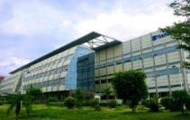
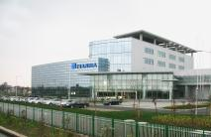

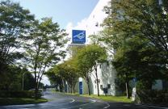
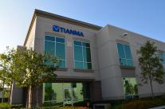
>>
Industrial Service Locations
Düsseldorf
Europe
Korea
Karlsruhe
Europe
NLT Japan
Detroit
USA
Shenzhen
Sales& R&D Center
Headquarters
Shanghai
Sales& R&D Center
Chino
USA
Europe
Shenzhen
Shanghai
Korea
Japan NLT
USA
Notes:
研发中心：日本，深圳，武汉，上海，厦门，成都
生产线：武汉2，成都1，上海3，深圳1，厦门2，日本2

Slide 15


>>
Dual-Brand Strategy
The implementation of the “one company, two brands” dual-brand strategy, on the basis of the global different characteristics of NLT and TIANMA , builds a general relationship and forms their own regional specialties and brand reputation, is able to provide customers with the best product and solutions in the medical, financial, HMI, aviation , navigation and other industrial fields.
Professional Display Unit

Slide 16
















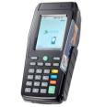
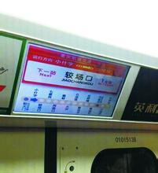

>>
Product application field
Medical Display
Medical-L
Medical-M
Medical-S
Home Healthcare
Industrial Display
ATM
POS
KIOSK
Avionics
Amusement
Cordless Phone
Construction
Machine
E-paper
Financial POS
HMI
Home
Automation
Industrial
Mobile
MFP
Measurement
Tester
Marine
POS
Trans-
portation
White
Goods

Slide 17









>>
Product – One-stop-shop service
Flexible perfect production line to bring customers the best economic benefits
TFT
Large volume
Product Line: Shanghai G5
TFT
Small volume , large variety
Product Line: Shanghai G4.5,
Chengdu G4.5, Japan G2.5 & G3
Customization
Full Range Product Line ( 1”~32”)
Monochrome
Product Line: Shenzhen TN &STN
Small-volume large-variety product
PCAP
Product Line : Shenzhen PCAP
Japan PCAP

Slide 18

>>
Service - Long-term Supply
Long-term Supplier Management on Supply Chain
Professional Team --- PDU
Continuous Investment
44kk/M~4.0”
34kk/M~4.0”
3.4kk/M~4.0”
Flexible Production Line
( TN/STN/G2.5/G3/G4.5/G5/G5.5/G6/AMOLED/ PCAP)

Slide 19
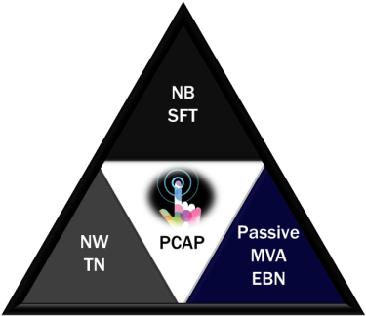
>>
Technology – Total Solution
Wide
View
Viewing Angle（U/D/L/R）：85/85/85/85
3D
2D-3D Switchable GRAIN LC lens Glass free 3D and HDDP
Transf
-lective
Outdoor Visible
SFT
Flexible
Prepare for flexible ,
light and thin display
TF
High
Resolution
NW TN
Resolution: WQHD ,
≥200 ppi
TFT
Technology
Touch
a-Si, LTPS , Oxide and other advanced technology.
Free Form
OGS, On-cell, In-cell
integrated touch total solution.
corner-cut and round-shape
While developing the technical scheme, We have 3396 authorized patents as of 2014.
We have hundreds of new patent applications each year.

Slide 20
>>
Tianma Industrial Quality
2015 PPM Target
High-end
500
General
1000·2000
To be
customer’s
quality
preference
ASSURANCE
CSR input
Risk assessment in development phase
Product verification test
Quality Manufacturing System
Product Audit
On-going Reliability Test
Industrial AVL
Supplier Ranking System
Supplier in-process control monitor
On-site Technical / Quality Support
In-house FA
Account team
Design Quality
Manufacture Quality
Supply Chain Quality
Fast Response
Quality through prevention

Slide 21
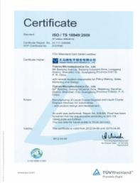
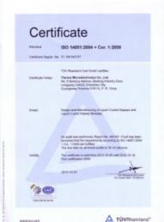
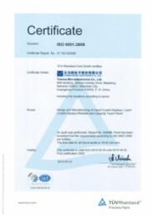
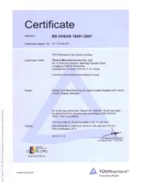

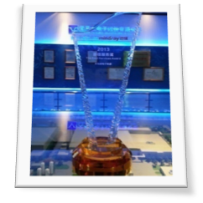


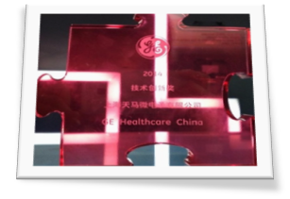
>>
Quality Certificate
ISO / TS 16949: 2009
ISO 14001: 2004
ISO 9001: 2008
BS OHSAS 18001: 2007
QC080000
Best Service Award 2013, Mindray
Best Quality Supplier Award 2014, AVAYA
Technical Innovation Award 2014, GE China
Best Component Supplier 2015 , AVAYA

Slide 22






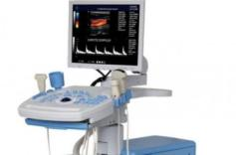
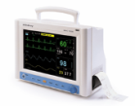


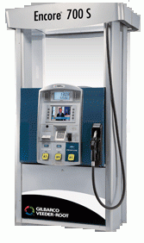
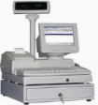
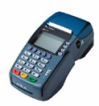


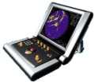




>>
Product Footprint
Coffee Machine
Coffee Machine
ATM
Audiphone
Control System
IP Phone
Medical
Monitor
Oscilloscope
IP Phone
Oiling Machine
POS
POS
POS
POS
Respirator
Ship Navigation
Visual Doorbell
Thermostat
Telecontroller

Slide 23



























>>
Industrial Customers
Medical
HMI
POS&ATM
Home
Automation
White
Goods

Slide 24















>>
Industrial Customers
Construction Machine
Measure-
ment
Avionics
Marine
Construction
Machine
MFP
VOIP
Industrial
Mobile

Slide 25
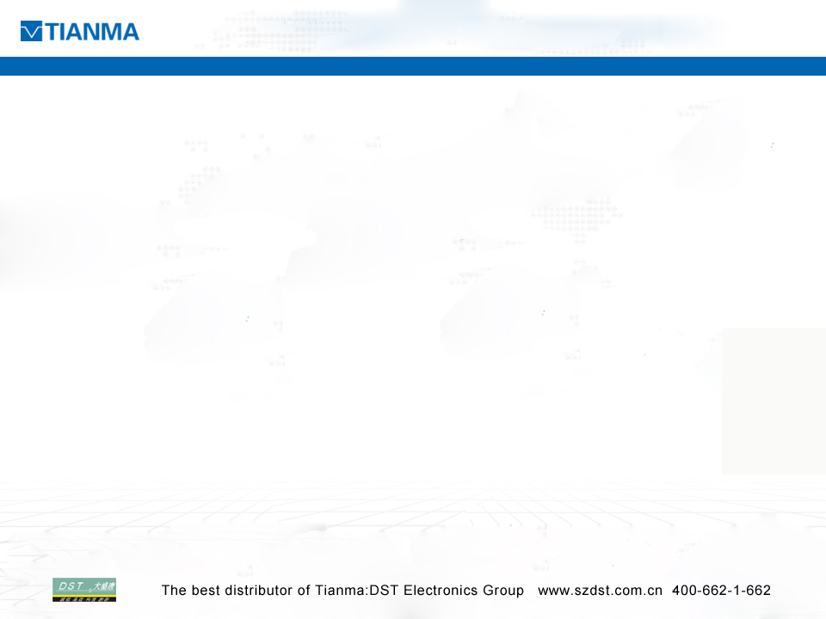
TIANMA / NLT-Your best partner
dual-brand of TIANMA and NLT
lower-end to High-end
LTPS / a-si / Passive / AM-OLED / Touch
standard products and customized products
G4.5 and G5 production lines
Wide-Range
product line
PDBU division
Specialized production line (cell and MOD)
Dedicated Quality system
Globalization service
Dedicated
team
Long-term supply
3-5 years long-term supply
Long-term
investment and management
Augmentation of LTPS and AMOLED production line
Advanced technology investment in R&D
Policy support

Slide 26



